Slide 1

Database Management system
Chapter 3
The Relational Data Model
&
Relational Database constraints
Dr. Rihab Mohamed Naceur ABDELKRIM
E-mail: rihab@su.edu.sa
2017 - 2018

Slide 2
Chapter Outline
1- Relational Model Concepts
2- Relational Model Constraints and Relational Database Schemas
3- Update Operations, Transactions and Dealing with Constraint Violations
4-codd’s rule for relational database

Slide 3
2- Relational Model Constraints and Relational Database Schemas
2-1- Definition of constraint
Constraints determine which values are permissible and which are not in the database.
They are of three main types:
Inherent or Implicit Constraints: These are based on the data model itself. (E.g., relational model does not allow a list as a value for any attribute)
2. Schema-based or Explicit Constraints: They are expressed in the schema by using the facilities provided by the model. (E.g., max. cardinality constraint in the ER model)
3. Application based or semantic constraints: These are beyond the expressive power of the model and must be specified and enforced by the application programs.

Slide 4
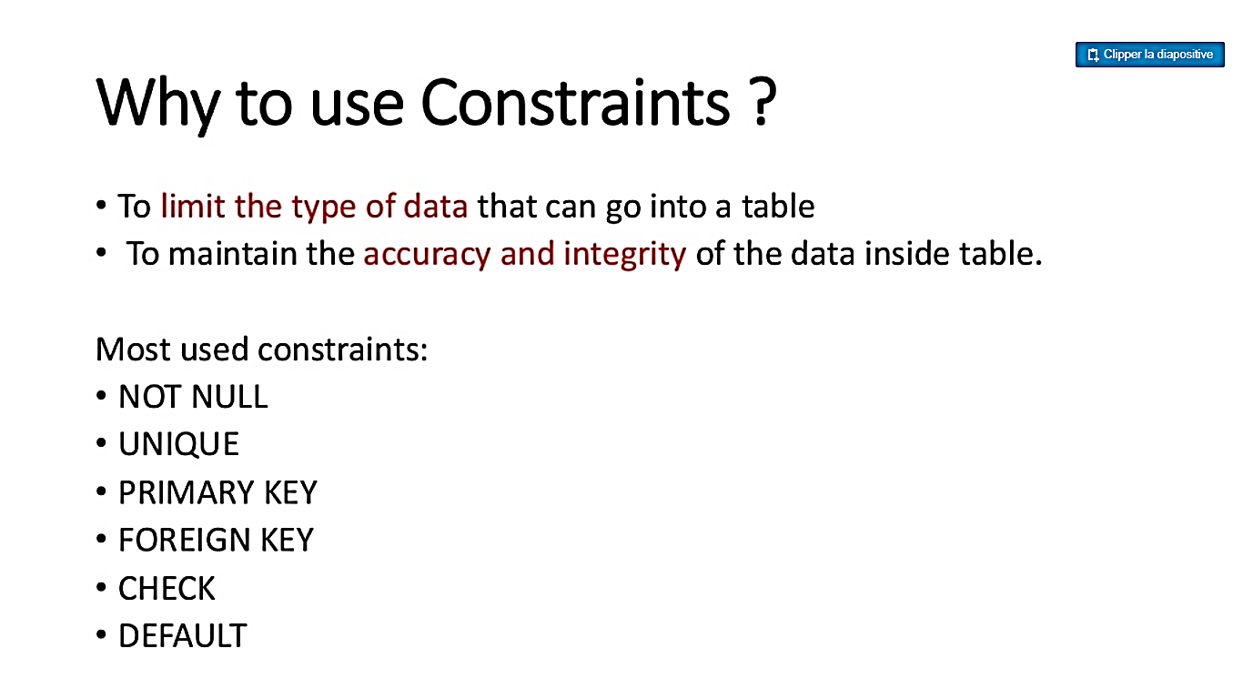
2- Relational Model Constraints and Relational Database Schemas
2-1- Definition of constraint

Slide 5
2- Relational Model Constraints and Relational Database Schemas
2-2- Relational integrity constraints
Constraints are conditions that must hold on all valid relation states.
There are three main types of (explicit schema-based) constraints that can be expressed in the relational model:
Key constraints
Entity integrity constraints (Primary key)
Referential integrity constraints (foreign key)
Another schema-based constraint is the domain constraint
Every value in a tuple must be from the domain of its attribute (or it could be null, if allowed for that attribute)

Slide 6
2- Relational Model Constraints and Relational Database Schemas
2-2- Relational integrity constraints
2-2-1- Key constraints
Superkey of R:
Is a set of attributes SK of R with the following condition:
No two tuples in any valid relation state r(R) will have the same value for SK
That is, for any distinct tuples t1 and t2 in r(R), t1[SK] ≠ t2[SK]
This condition must hold in any valid state r(R).
Key of R:
A "minimal" superkey
That is, a key is a superkey K such that removal of any attribute from K results in a set of attributes that is not a superkey (does not possess the superkey uniqueness property)
A Key is a Superkey but not vice versa.

Slide 7
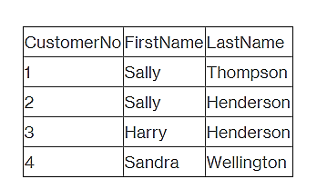
2- Relational Model Constraints and Relational Database Schemas
2-2- Relational integrity constraints
2-2-2- Entity integrity constraints (Primary key)
A primary key is a column (or columns) in a table that uniquely identifies the rows in that table.
Customer
For example, in the table above, CustomerNo is the primary key.
The values placed in primary key columns must be unique for each row: no duplicates can be tolerated. In addition, nulls are not allowed in primary key columns.
Entity integrity constraints : No primary key value can be NULL

Slide 8
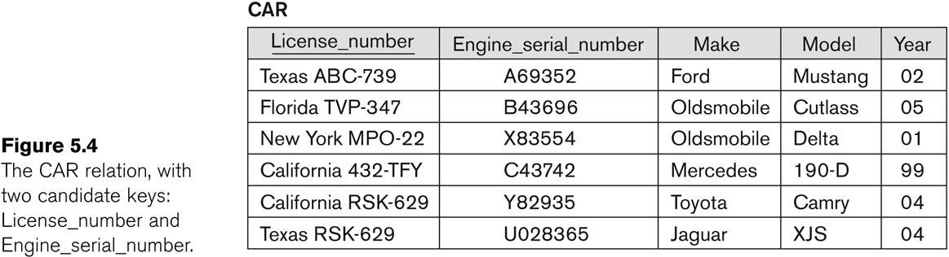
2- Relational Model Constraints and Relational Database Schemas
2-2- Relational integrity constraints
2-2-2- Entity integrity constraints (Primary key)
Example

Slide 9
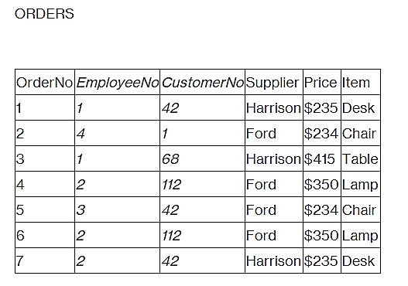
2- Relational Model Constraints and Relational Database Schemas
2-2- Relational integrity constraints
2-2-3- Referential integrity constraints (foreign key)
Foreign keys are columns that point to primary key columns. So, for example, OrderNo is the primary key of the table ORDERS below and CustomerNo is a foreign key that points to the primary key in the CUSTOMERS table.
Remark :
Referential integrity constraints : A foreign key must match its primary key unless it's NULL.

Slide 10
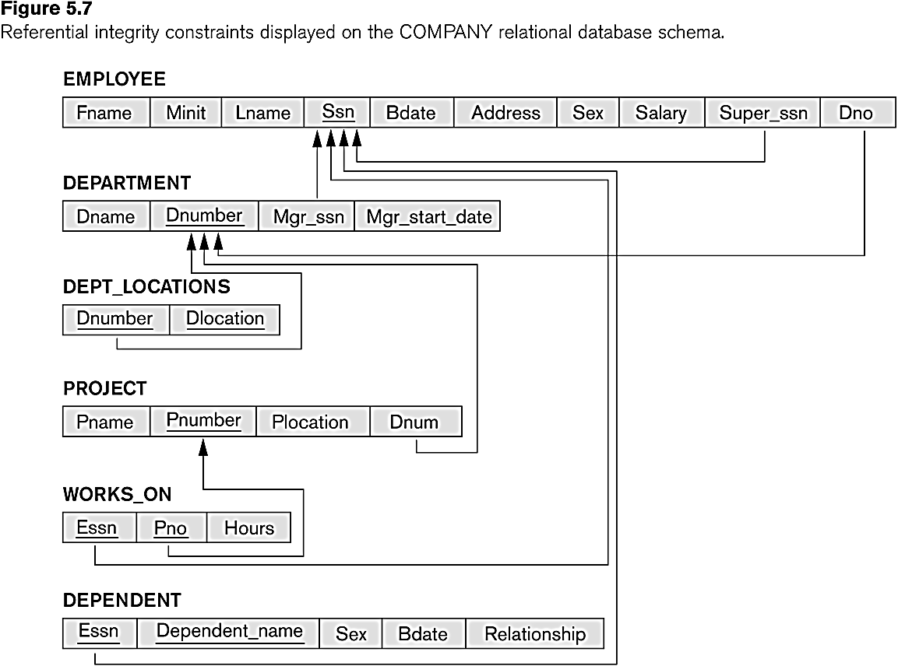
2- Relational Model Constraints and Relational Database Schemas
2-2- Relational integrity constraints
2-2-3- Referential integrity constraints (foreign key)
Example

Slide 11
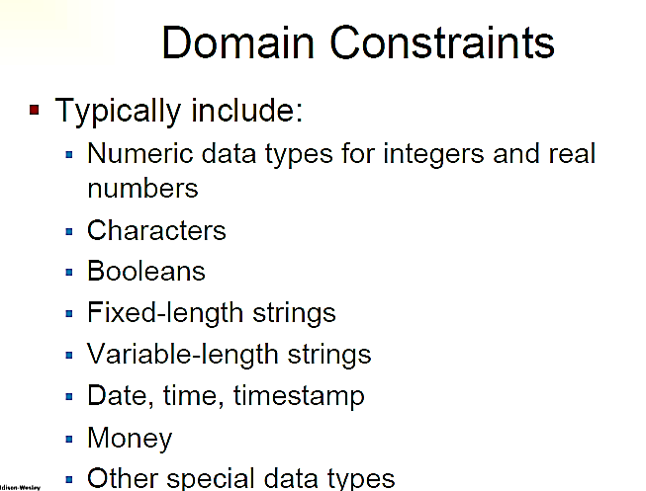
2- Relational Model Constraints and Relational Database Schemas
2-2- Relational integrity constraints
2-2-4- Domain constraint

Slide 12
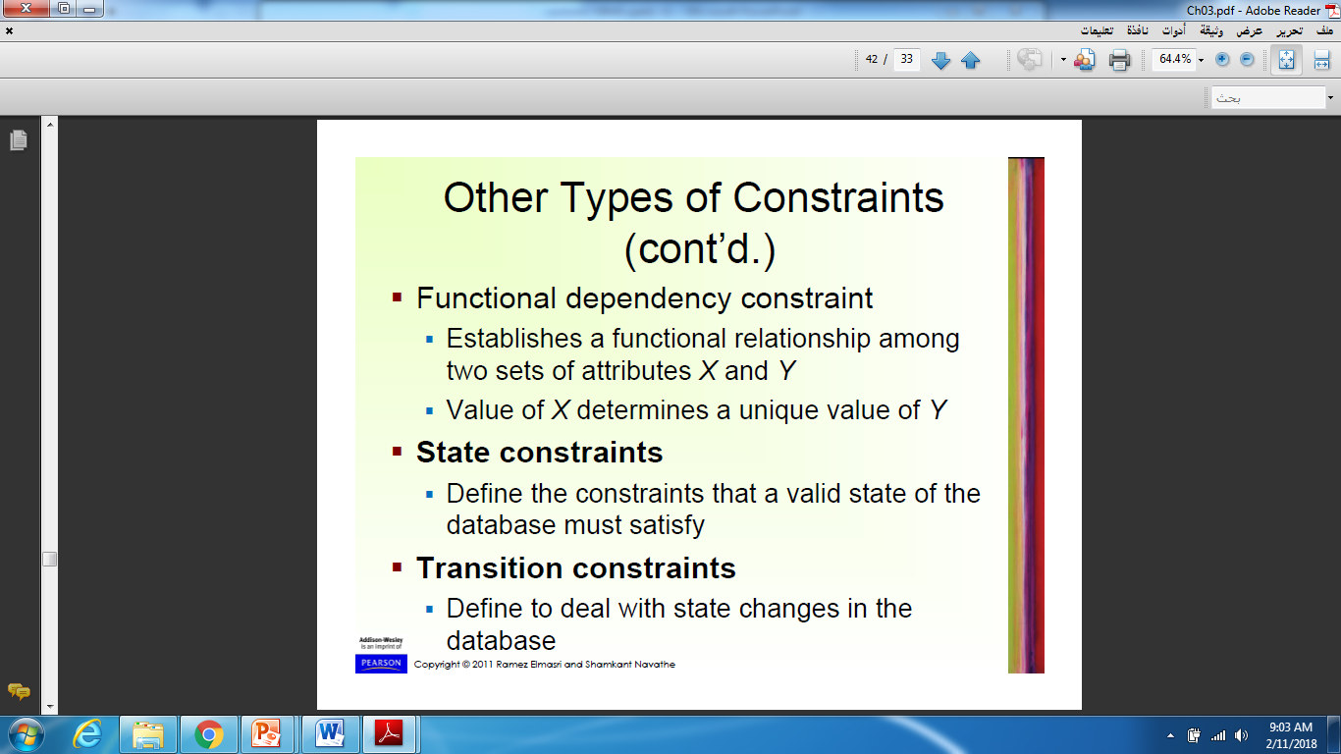
2- Relational Model Constraints and Relational Database Schemas
2-3- Other Types of Constraints

Slide 13
2-4- Relational Database Schema
2- Relational Model Constraints and Relational Database Schemas
Relational Database Schema:
A set S of relation schemas that belong to the same database.
S is the name of the whole database schema
S = {R1, R2, ..., Rn} and a set IC of integrity constraints.
R1, R2, …, Rn are the names of the individual relation schemas within the database S
Following slide shows a COMPANY database schema with 6 relation schemas

Slide 14
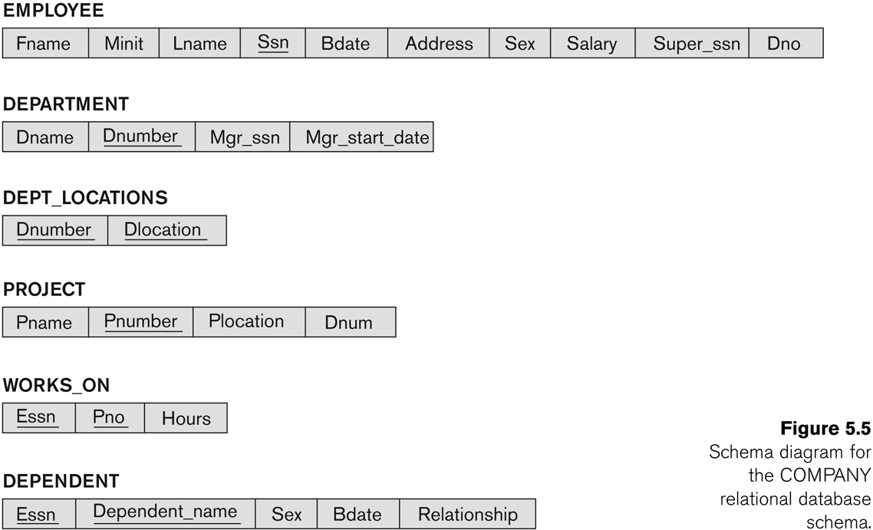
2- Relational Model Constraints and Relational Database Schemas
2-4- Relational Database Schema
Example: Company database schema
Primary key

Slide 15
2- Relational Model Constraints and Relational Database Schemas
2-4- Relational Database State
A relational database state DB of S is a set of relation states DB = {r₁, r₂, ..., r_{m}} such that each r_{i} is a state of R_{i} and such that the r_{i} relation states satisfy the integrity constraints specified in IC.
Remarks:
When we refer to a relational database, we implicitly include both its schema and its current state.
A database state that does not obey all the integrity constraints is an invalid state.
A state that satisfies all the constraints in the defined set
of integrity constraints IC is called a valid state.

Slide 16
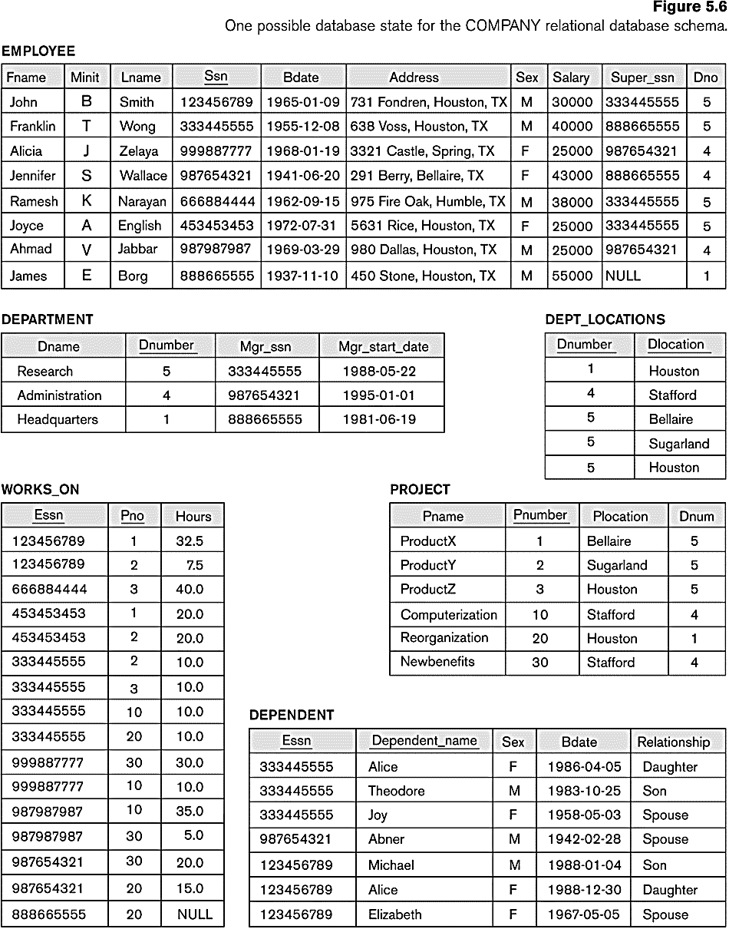
2- Relational Model Constraints and Relational Database Schemas
2-4- Relational Database State
Example
Primary key

Slide 17
3- Update Operations, Transactions and Dealing with Constraint Violations
In case of integrity violation, several actions can be taken:
Cancel the operation that causes the violation (RESTRICT or REJECT option)
Perform the operation but inform the user of the violation
Trigger additional updates so the violation is corrected (CASCADE option, SET NULL option)
Execute a user-specified error-correction routine

Slide 18
3- Update Operations, Transactions and Dealing with Constraint Violations
Possible violations for each operation
INSERT may violate any of the constraints:
Domain constraint:
if one of the attribute values provided for the new tuple is not of the specified attribute domain
Key constraint:
if the value of a key attribute in the new tuple already exists in another tuple in the relation
Referential integrity:
if a foreign key value in the new tuple references a primary key value that does not exist in the referenced relation
Entity integrity:
if the primary key value is null in the new tuple

Slide 19
3- Update Operations, Transactions and Dealing with Constraint Violations
Possible violations for each operation
DELETE may violate only referential integrity:
If the primary key value of the tuple being deleted is referenced from other tuples in the database
Can be remedied by several actions: RESTRICT, CASCADE, SET NULL
RESTRICT option: reject the deletion
CASCADE option: propagate the new primary key value into the foreign keys of the referencing tuples
SET NULL option: set the foreign keys of the referencing tuples to NULL
One of the above options must be specified during database design for each foreign key constraint

Slide 20
3- Update Operations, Transactions and Dealing with Constraint Violations
Possible violations for each operation
UPDATE may violate domain constraint and NOT NULL constraint on an attribute being modified
Any of the other constraints may also be violated, depending on the attribute being updated:
Updating the primary key (PK):
Similar to a DELETE followed by an INSERT.
Need to specify similar options to DELETE.
Updating a foreign key (FK):
May violate referential integrity.
Updating an ordinary attribute (neither PK nor FK):
Can only violate domain constraints.

Slide 21
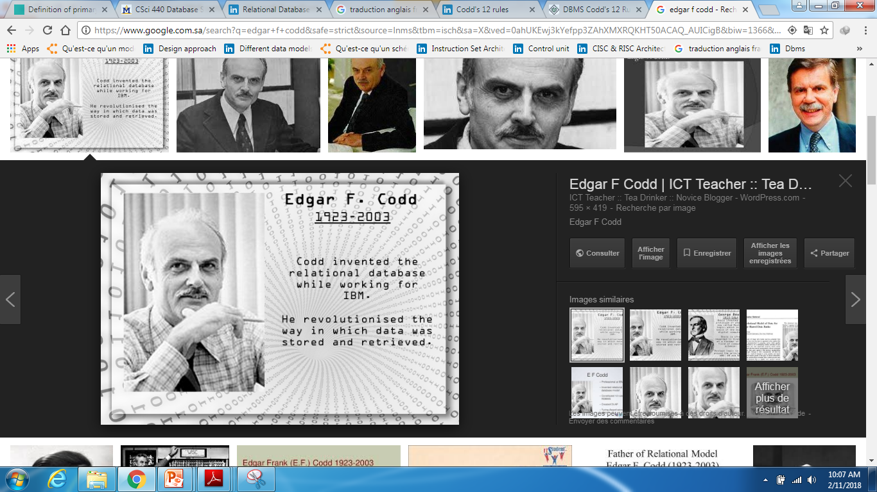
4-codd’s rule for relational
database
Dr Edgar F. Codd, after his extensive research on the Relational Model of database systems, came up with twelve rules of his own, which according to him, a database must obey in order to be regarded as a true relational database.
These rules can be applied on any database system that manages stored data using only its relational capabilities.
This is a foundation rule, which acts as a base for all the other rules.

Slide 22
4-codd’s rule for relational
database
Rule 1: Information Rule
The data stored in a database, may it be user data or metadata, must be a value of some table cell. Everything in a database must be stored in a table format.
Rule 2: Guaranteed Access Rule
Every single data element (value) is guaranteed to be accessible logically with a combination of table-name, primary-key (row value), and attribute-name (column value). No other means, such as pointers, can be used to access data.

Slide 23
4-codd’s rule for relational database
Rule 3: Systematic Treatment of NULL Values
The NULL values in a database must be given a systematic and uniform treatment. This is a very important rule because a NULL can be interpreted as one the following − data is missing, data is not known, or data is not applicable.
Rule 4: Active Online Catalog
The structure description of the entire database must be stored in an online catalog, known as data dictionary, which can be accessed by authorized users. Users can use the same query language to access the catalog which they use to access the database itself.

Slide 24
4-codd’s rule for relational database
Rule 5: Comprehensive Data Sub-Language Rule
A database can only be accessed using a language having linear syntax that supports data definition, data manipulation, and transaction management operations. This language can be used directly or by means of some application. If the database allows access to data without any help of this language, then it is considered as a violation.

Slide 25
4-codd’s rule for relational database
Rule 6: View Updating Rule
All the views of a database, which can theoretically be updated, must also be updatable by the system.
Rule 7: High-Level Insert, Update, and Delete Rule
A database must support high-level insertion, updation, and deletion.
This must not be limited to a single row, that is, it must also support union, intersection and minus operations to yield sets of data records
Rule 8: Physical Data Independence
The data stored in a database must be independent of the applications that access the database.
Any change in the physical structure of a database must not have any impact on how the data is being accessed by external applications.

Slide 26
4-codd’s rule for relational database
Rule 9: Logical Data Independence
The logical data in a database must be independent of its user’s view (application). Any change in logical data must not affect the applications using it. For example, if two tables are merged or one is split into two different tables, there should be no impact or change on the user application. This is one of the most difficult rule to apply.
Rule 10: Integrity Independence
A database must be independent of the application that uses it. All its integrity constraints can be independently modified without the need of any change in the application. This rule makes a database independent of the front-end application and its interface.

Slide 27
4-codd’s rule for relational database
Rule 11: Distribution Independence
The end-user must not be able to see that the data is distributed over various locations.
Users should always get the impression that the data is located at one site only. This rule has been regarded as the foundation of distributed database systems.
Rule 12: Non-Subversion Rule
If a system has an interface that provides access to low-level records, then the interface must not be able to subvert the system and bypass security and integrity constraints.

Slide 28
Do you have any questions ???
???

